Slide 1
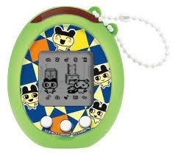
While you wait…
Install Python 2.7, py(win)USB and PIL
http://www.pythonware.com/products/pil/
https://pypi.python.org/pypi/pywinusb/
Download the Tamagotchi tools
https://github.com/natashenka/Egg-Shell
Put batteries into your Tamagotchi
There’s a few screwdrivers floating around
Hatch your Tamagotchi
Press ‘B’ to get started
Connect the Egg Shell board to your laptop via USB make sure it’s detected as a HID
A
B
C

Slide 2
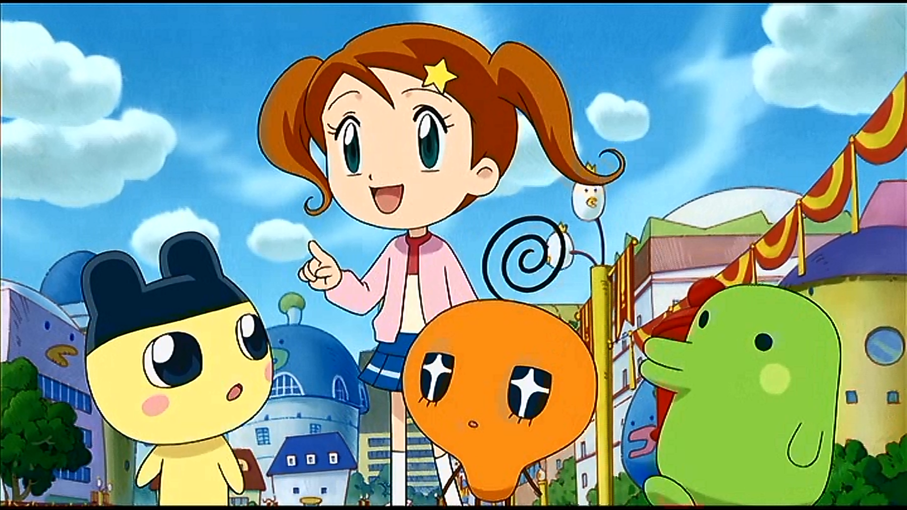
Hacking Tamagotchis
for Fun and…
… Well, That’s Pretty Much It
Natalie Silvanovich
@natashenka

Slide 3
Your Tamagotchi
Press ‘B’ button and enter details to start hatching
Once hatched, press ‘A’ to navigate, ‘B’ to select and ‘C’ to cancel
The top right icon is the figure icon (only appears when figure attached)
Most tools use figures
Press A + C to turn off sound
Feed it quickly before it dies!!!
A
B
C

Slide 4
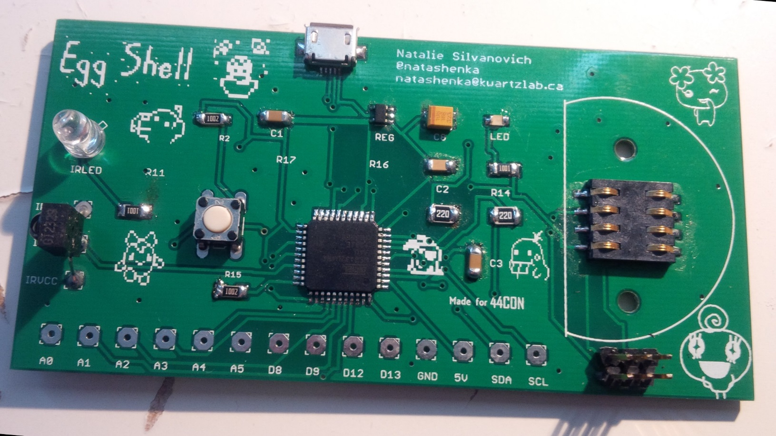
Egg Shell Board
Supports figure programming over SPI and IR (no software)
Detected as a HID over USB

Slide 5
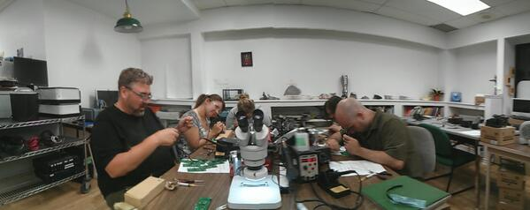
Assembled at Kwartzlab

Slide 6
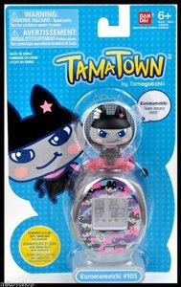
Programming a Figure
Use figurewrite.py to program figure
Loads figure image file onto figure
Image files must be 0x80000 bytes long
Board must be reset using button between each load
figurewrite.py infile
WARNING: program only the figure that came in separate packaging. Do NOT program the one that came with the Tamagotchi!! Tamagotchis (and boards) WILL DIE!!!!!!!!!!!

Slide 7
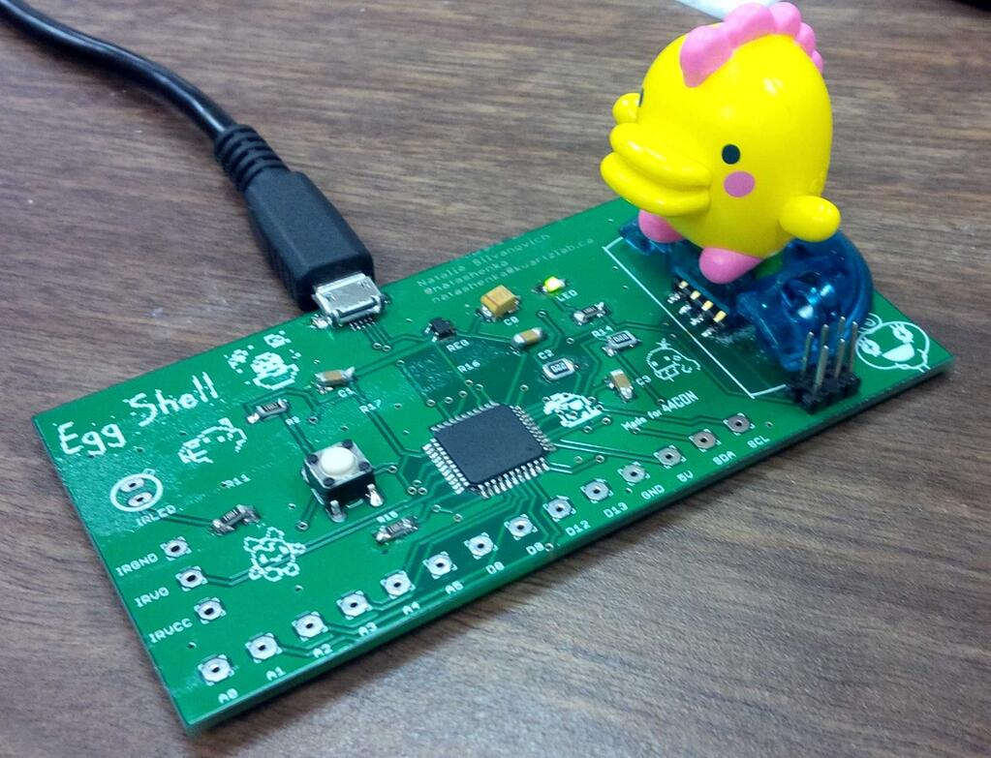
Programming a Figure
Programming a figure requires pressure!
Push hard!
Linux script is quite slow
Rubber bands at the front if holding gets too hard
Prize for anyone who speeds it up!

Slide 8
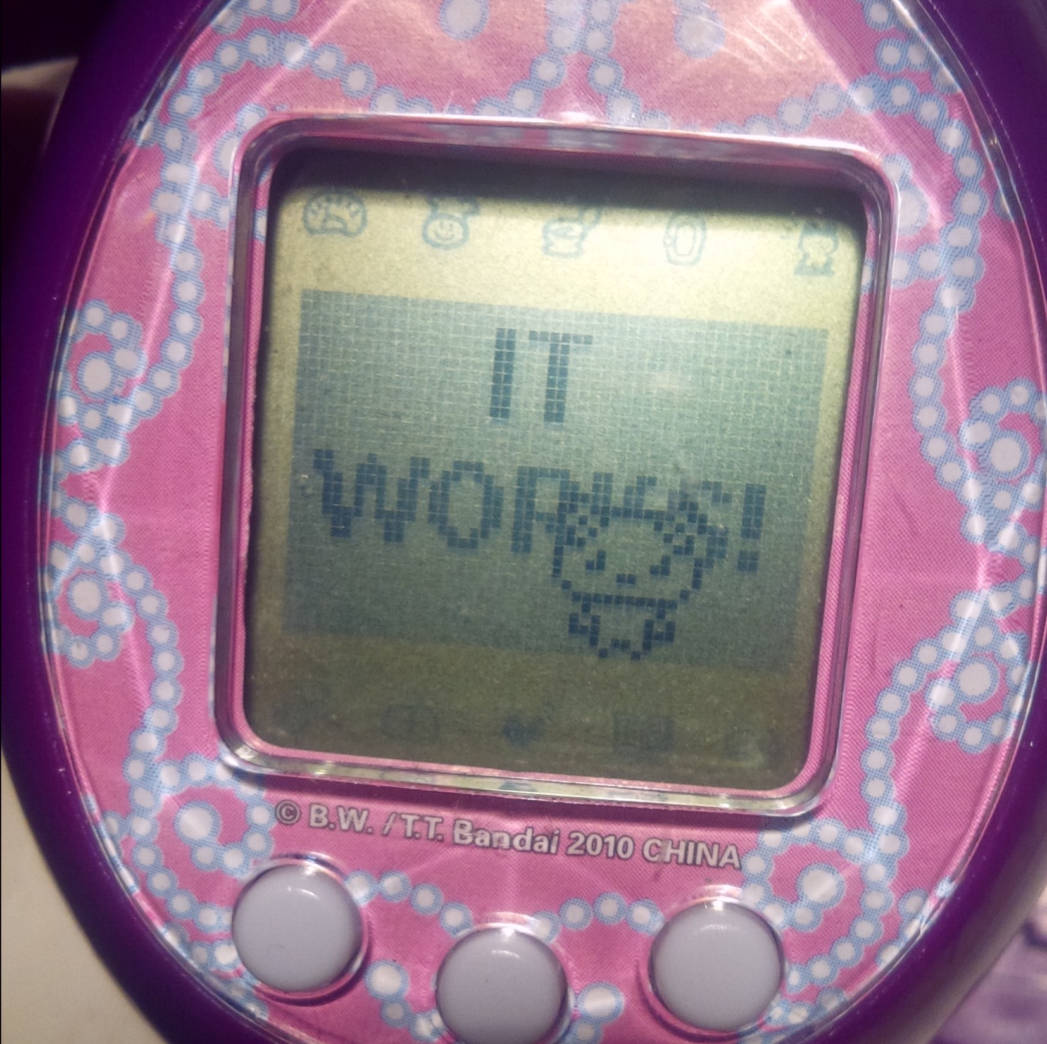
Testing the Board
Load Egg-Shell/test/itworks.txt
Attach figure

Slide 9
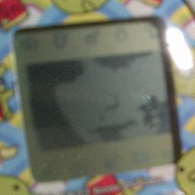
Creating Your Own Picture
Find a 48 x 31 picture
Or use one from /samples
Save it as a 16-bit bitmap using four tones
Note that images are three-tone. Dark grey, grey and white show up as expected. Black is transparent.
Run
Load image
Attach figure
portrait.py <your image> <outfile>

Slide 10
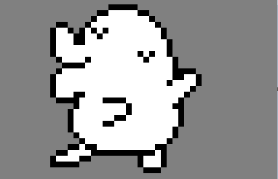
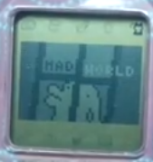
Creating a Tamagotchi Music Video
Create a script for your ‘video’
See /itemmake/samplescript
Add images and sound
Run
Load image
Buy item
There’s entropy involved!
Use item
itemmake.py <script> <outfile>

Slide 11
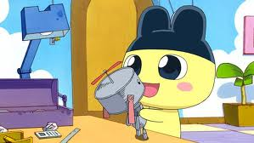
Writing Assembly
Write 6502 assembly
See /6502/samples
0x100 – 0x200 is usable RAM
The stack is great too
Check README for convenience functions
Run
Load image onto figure
Play “Sound Block” in the figure games
tASMgotchi.py <infile> <images> -o <outfile>

Slide 12
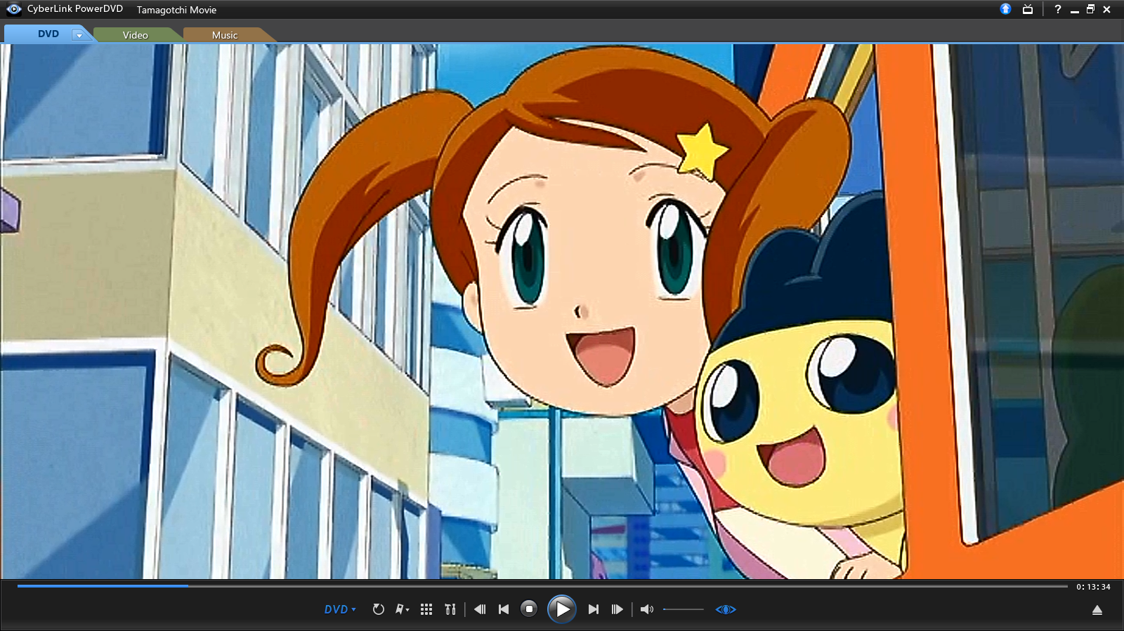
Have fun!!

Slide 13
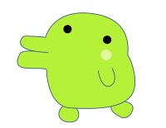








Questions?
natashenka@kwartzlab.ca
@natashenka
Don’t forget to show me all the cool stuff you made!

